Slide 1





Mini Project Presentation
Smart Roadways: Integrating Automatic Dynamic Charging of EVs
Rohith H | 1AT21EC130
Tejas S Suthrave | 1AT21EC167
Teju B | 1AT21EC169
Vishwas V | 1AT21EC182
Project Guide :
Prof. GAYATHRI JOSHI
Dept. of ECE, Atria I T,
Bengaluru
Department of Electronics & Communication Engineering,
Atria Institute of Technology, Bengaluru

Slide 2
Presentation Overview
Introduction
Literature review
Problem statement
Objectives
Hardware & software Requirements
Proposed Work
Proposed block diagram
Project Overview
Working Principle
Applications
Advantages
Outcome
Gantt Chart
References

Slide 3
Introduction
The transportation sector is undergoing significant changes due to the increasing adoption of electric vehicles (EVs).
EVs offer environmental benefits and reduce dependence on fossil fuels.
Despite their benefits, people have concerns about limited driving range and lengthy charging times.
This project is looking into a new way to charge electric cars (EVs) while they are driving. This could help solve the problems of EVs not being able to go very far on one charge and taking a long time to recharge.
On-road dynamic charging, also known as in-motion charging or dynamic wireless charging, plans a future where EVs can be continuously charged while driving.

Slide 4
Literature Review
Authors | Title, Contributions and Observations
“A Review on Progress in Wireless Charging Technologies for Electric Vehicles “D. Sai Kumar1 and Dr. D Rajesh Babu ,2024 | It covers key developments like Inductive Power Transfer (IPT) and resonant inductive coupling. The paper explains the benefits of using high frequencies, the potential of charging cars while they are moving, and the need for standardization and safety.
DYNAMIC CHARGING OF ELECTRIC VEHICLES Viknesvaran C K, Priyadharshini P, Santhosh R J, and Prakash N, May 2022 | It explains how charging while driving can extend driving range and reduce battery size. it highlights the challenges of integrating dynamic charging into existing roadways and the potential benefits for reducing charging time and improving convenience for EV users.
Sustainability of Dynamic Wireless Power Transfer Roadway for In-Motion Electric Vehicle Charging, March 2024 | It explains how Dynamic wireless charging systems enable EVs to charge while in motion, using electromagnetic fields to transfer energy between coils embedded in the roadway and the vehicle.

Slide 5
Problem Statement
Electric vehicles (EVs) are crucial for a sustainable future, but current charging solutions have many challenges.
Plugged charging requires manual intervention, limits travel flexibility, and consumes more time to charge.
While wireless electric vehicle charging systems (WEVCS) offer a convenient alternative, integrating them dynamically into roadways presents significant problems.
This project addresses the need to develop a system for automatic dynamic charging of EVs, overcoming limitations in efficiency, safety, and cost-effectiveness.

Slide 6
Objectives
The primary objective of this project is to find the feasibility and practical implementation of on-road dynamic charging systems for electric vehicles (EVs)
To evaluate the current technologies available for dynamic wireless charging, including their efficiency, range, and safety.
To identify the infrastructure needed for implementing on-road dynamic charging.

Slide 7
Hardware & software Requirements
Hardware Requirements:
PWM IC – KA3525A
MOSFETs – IRF540
Antenna Type – Circular Loop Antenna
Antenna Alignment – Axial
Coil Impedance – 24Ohms
Wire Gauge : 20SWG
No. of . Turns: 60Turns
Coil Diameter : 140mm

Slide 8
Proposed Work
In the proposed system aims to develop an antenna and wireless power transfer system suitable for electric vehicles (EVs).
Using resonant magnetic coupling principle, the wireless power transfer technology to the electric vehicle is designed.
When the vehicle’s power receiver’s frequency is tuned in exact with the resonance frequency of the transmitter unit below the road, the electrical power will flow from the transmitter coil inside the platform to the receiving coil inside the bottom of the electric vehicle.
This project describes the design and implementation of a wireless power transfer system for moving electric vehicles of any type like e-cars or e-bikes.

Slide 9
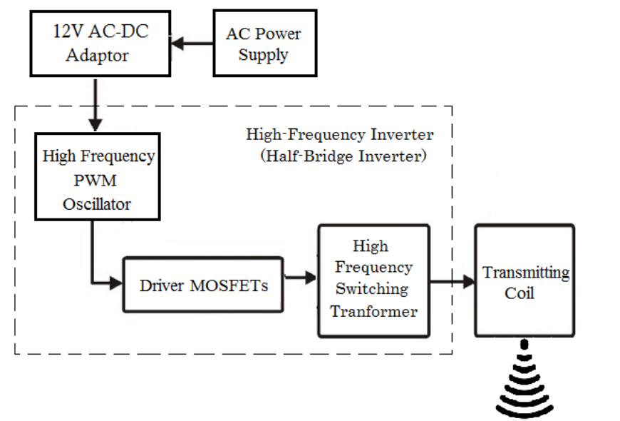
Transmitter Block Diagram
Proposed Block Diagram

Slide 10
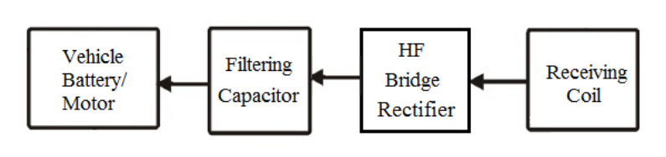
Receiver Block Diagram
Proposed Block Diagram

Slide 11
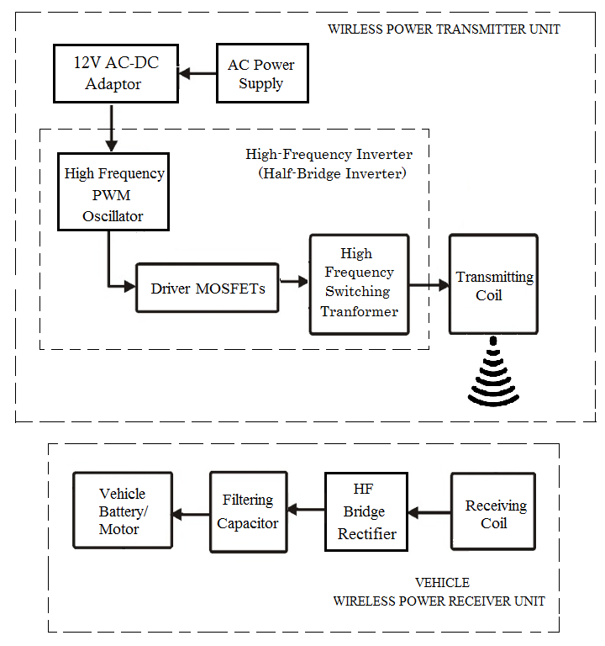
Project Overview

Slide 12
Working principle (Transmitter)
Working Principle
AC-DC Converter or Switching Mode Power Supply (SMPS) converts 220V 50Hz AC supply into 24V DC output.
The converted DC is then converted into a High frequency AC using a high frequency resonant half- bridge pwm inverter.
The HF inverter used here is a half bridge push-pull type inverter.
It is operated using a PWM switching controller which produces 45 to 120KHz oscillator Frequency.
The HF converter converts Dc to HF ac. The HF ac current is fed to a switching transformer, which drives the HF Ac power to the transmitting coil.
Transmitting coils convert HF electrical current into electromagnetic waves.
The transmitting coil is operated at its resonant frequency so that maximum power will be transmitted with higher output efficiency.

Slide 13
Working principle (Receiver)
Working Principle
The receiver consists of a receiving coil which is tuned to the frequency of the transmitting coil.
So when coils are within the coupling range, the power is received in the receiving coil.
The receiving coil converts the electromagnetic waves back to HF AC output.
High frequency AC current is converted into a DC current using a fast switching bridge rectifier.
A capacitor filter is used, which stabilizes the Dc voltage and produces a constant Dc output.
Then the output of he filtering circuit provide a constant charging current to batteries of vehicle.

Slide 14
Applications
Applications:
Wireless power has a bright future in providing wireless electricity. There are no limitations in power applications. Some of the potential applications are powering of cell phones, laptops and other devices that normally run with the help of batteries or plugging in wires.
Wireless power applications are expected to work on the gadgets that are in close proximity to a source of wireless 'power, where in the gadgets charges automatically without necessarily, having to get plugged in.
By the use of Wireless power there is no need of batteries or remembering to recharge batteries periodically. If a source is placed in each room to provide power supply to the whole house
Wireless power has many medical applications. It is used for providing electric power in many commercially available medical implantable devices.
Another application of this technology includes transmission of information. It would not interfere with radio waves and it is cheap and efficient.

Slide 15
Advantages
No need of line of sight - In Wireless power transmission there is any need of line of sight between transmitter and receiver. That is power transmission can be possible if there is any obstructions like wood, metal, or other devices were placed in between the transmitter and receiver.
No need of power cables and batteries - Wireless power replaces the use of power cables and batteries.
Does not interfere with radio waves
Negative health implications - By the use of resonant coupling wave lengths produced are far lower and thus make it harmless.
Highly efficient than electromagnetic induction - Electromagnetic induction system can be used for wireless energy transfer only if the primary and secondary are in very close proximity. Resonant induction system is one million times as efficient as electromagnetic induction system.
Less costly - The components of transmitter and receivers are cheaper. So this system is less costly.

Slide 16
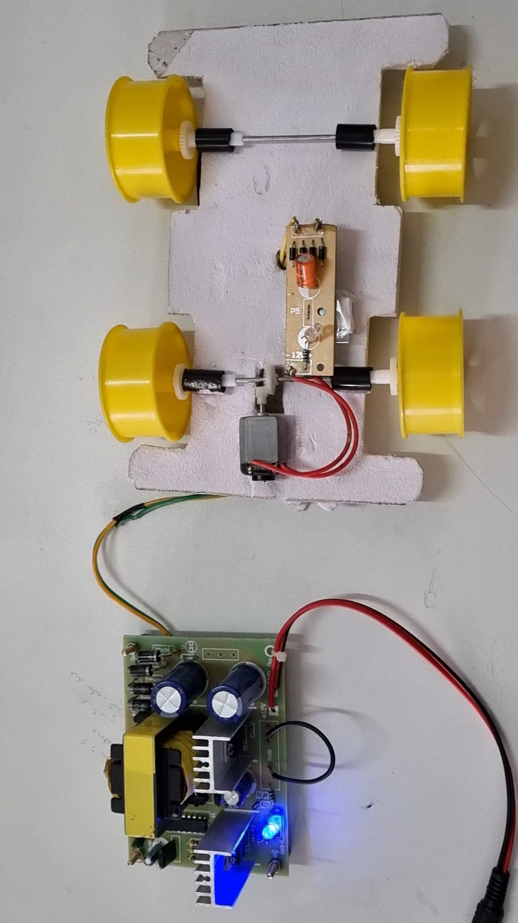
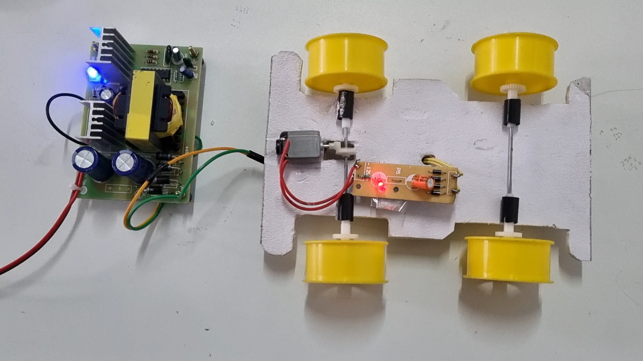
Outcomes of the Project
Figure 5
Figure 6
In figure (1) there is no contact between transmitting coil and receiving coil. So power is not transferred and cannot be charged
In figure(2) there is a contact between transmitting coil and receiving coil. Due to Inductive Power Transfer (IPT) contactless ev charging is done.

Slide 17
Gantt Chart
Month | First week | Second week | Third week | Fourth week
June | Batch Creation | Guide allotment And interaction with Guide for project title selection | Synopsis Submission and approval by the guide. | Synopsis Phase one presentation
July | Acquiring Components and Configuring components. | Testing Phase and making adjustments. Interaction with guide. | Working model completion. Project approval and interaction with guide | Final adjustments and Final presentation.

Slide 18
References
T. Newbolt, P. Mandal, H. Wang and R. Zane, “Sustainability of Dynamic Wireless Power Transfer Roadway for In-Motion Electric Vehicle Charging”, vol. 10, IEEE Transactions on Transportation Electrification, March 2024.
Garg S, Khare S, Kshetre J, Sahu R, Thakur K, Singh A, Bhongade S, "Static and dynamic wireless charging of electric vehicles using inductive coupling," Indian Journal of Engineering, vol. 20, no. 53, 2023.
S. S. G. Acharige, M. E. Haque, M. T. Arif, N. Hosseinzadeh, K. N. Hasan and A. M. T. Oo, "Review of Electric Vehicle Charging Technologies, Standards, Architectures, and Converter Configurations," IEEE Access, vol. 11, no. 2023, pp. 41218-41255, 2023.
S. B. a. A. R. Saxena, "Electric Vehicles Scenario and its Charging Infrastructure in India," in IEEE 10th Power India International Conference (PIICON),, New Delhi, 2022.

Slide 19
Thank You

